Slide 1
Operating System
Introduction

Slide 2
Books and References
Text Books:
1.Silberschatz, A. and P. B. Galvin, Operating System Concepts, Sixth Edition, John-Wiley. (not Java edition)
2.Tanenbaum, A. S., Modern Operating Systems, Second Edition, PHI.
References :
1. Research and Technical Papers
2. Stallings, W., Operating Systems, Fourth Edition, Pearson.

Slide 3
Unit –I
-Historical background: Operating system evolution, hardware review, operating system structure.
-Overview of Operating System: batch system, multiprogramming, time-sharing, real-time, mainframe operating systems, personal computer operating systems, system calls

Slide 4
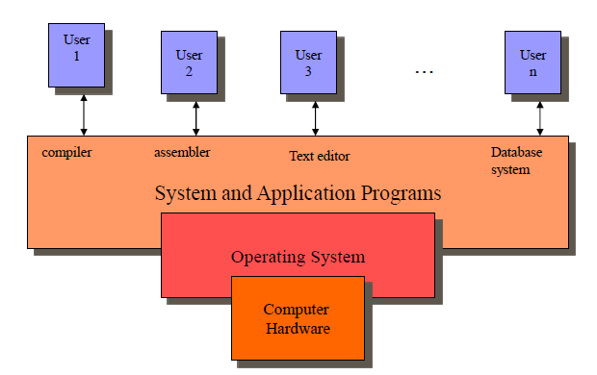
Abstract View of System

Slide 5
Computer System Components
Hardware
Provides basic computing resources (CPU, memory, I/O devices).
Operating System
Controls and coordinates the use of hardware among application programs.
Application Programs
Solve computing problems of users (compilers, database systems, video games, business programs such as banking software).
Users
People, machines, other computers

Slide 6
What is Operating System?
An OS is a program that acts an intermediary between the user of a computer and computer hardware.
OS simplifies and manages the complexity of running application programs efficiently.

Slide 7
Goals Of OS
Simplify the execution of user programs and make solving user problems easier.
Use computer hardware efficiently.
Allow Sharing of hardware and Software Resources.
Provide isolation, security and protection among user programs.

Slide 8
Operating systems Views
As a Resource allocator
to allocate resources (software and hardware) of the computer system and manage them efficiently.
As a controller
Controls execution of user programs and operation of I/O devices.

Slide 9
OS as an Extended Machine
OS function is to present the user with the equivalent of an extended machine or virtual machine that is easier to program than the underlying hardware.
OS creates higher-level abstraction for programmer.
What are the right abstractions? How to achieve this?

Slide 10
OS as an Extended Machine
Example: (Floppy disk I/O operation)
disks contains a collection of named files
each file must be open for READ/WRITE
after READ/WRITE complete close that file
no any detail to deal
OS shields the programmer from the disk hardware and presents a simple file oriented interface.

Slide 11
OS as a Resource Manager
OS primary function is to manage all pieces of a complex system.
-What happens if three programs try to print their output on the same printer at the same time?
-What happens if two network users try to update a shared document at same time?
OS should take care of these.

Slide 12
OS as resource Manager
Virtualizes resource so multiple users/applications can share
• Protect applications from one another
• Provide efficient and fair access to resources.
What mechanisms? What policies?

Slide 13
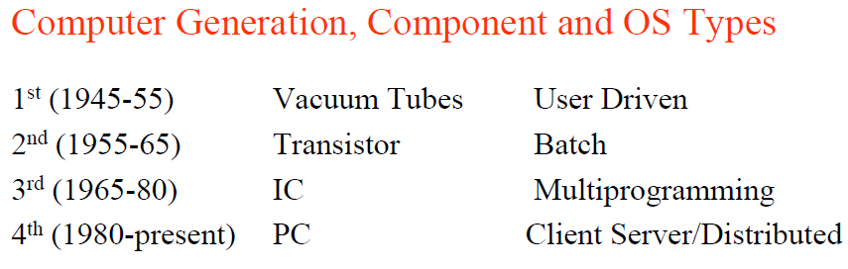
OS evolution( History)

Slide 14
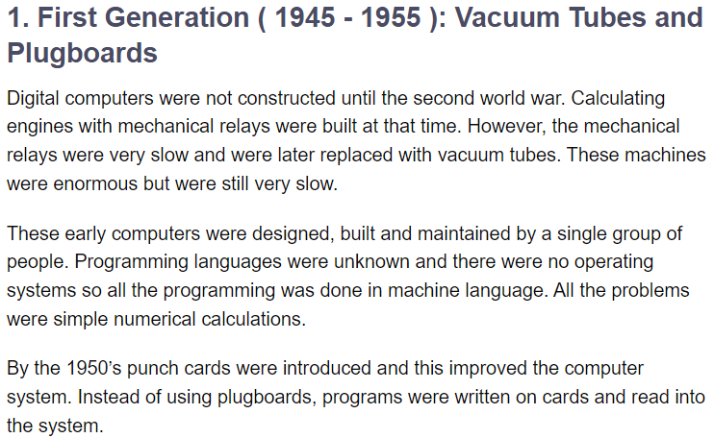
First Generation

Slide 15
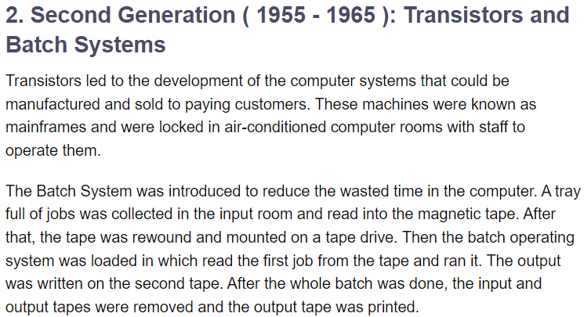
Second Generation

Slide 16
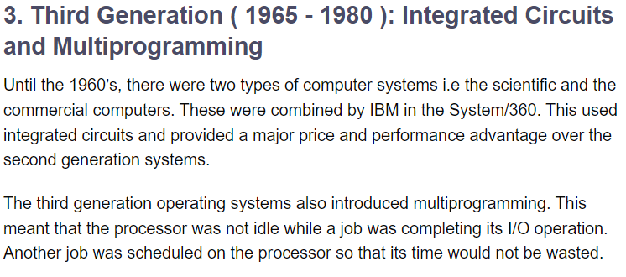
Third Generation

Slide 17
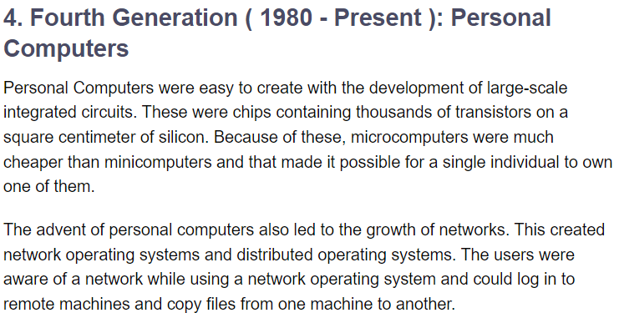
Fourth Generation

Slide 18
Evolution of OS
Batch system
Multiprogramming
Time-sharing
Real-time
Mainframe operating systems,
Multiprocessor operating systems
Handheld
Embedded, smart-card, distributed and personal computer operating systems

Slide 19
Batch System
During the 2ndgeneration, operator hired to run computer, the user prepared a job –which consisted of the program, the data, and some control information about the nature of the jobs –and submitted it to the computer operator. The operator perform the function of an OS.
Batch:Group of jobs submitted to machine together
Operator collects jobs; orders efficiently; runs one at a time

Slide 20
Batch System
Advantages:
Amortize setup costs over many jobs
Operator more skilled at loading tapes
Keep machine busy while programmer thinks
Problem:
User must wait for results until batch collected and submitted
(If bug receive, memory and register dump; submit job again!)

Slide 21
Multiprogramming
Multiple jobs in memory at the same time. Each memory space protected from each other. OS picks one, execute it for a while, stops (e.g. when programs reads for input or randomly), picks other to run.

Slide 22
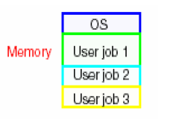
Multiprogramming
New OS functionality
• Job scheduling policies
•Memory management and protection (virtual memory)

Slide 23
Timesharing
Problem:
increasing number of users who want to interact with programs while they are running.
humans’ time is expensive don’t want to wait.
Solution
-Timesharing (a variant of Multiprogramming)
The CPU executes multiple jobs by switching among them, but the switches occurs so frequently that the user can interact with each program while it is running.

Slide 24
Timesharing
Goal: Improve user’s response time
Advantage:
Users easily submit jobs and get immediate feedback
New OS functionality
More complex job scheduling, memory management
Concurrency control and synchronization

Slide 25
Personal Computers
Dedicated machine per user
CPU utilization is not a prime concern
Hence, some of the design decision made for advanced system may not be appropriate for these smaller system. But other design decisions, such as those for security, are appropriate because PCs can now be connected to other computer and users through the network and the web.
There are the different types of OS for PC such as Windows, MacOS, UNIX, Linux.

Slide 26
Real-Time Systems
Time is a key parameter
Often used as a control device in a dedicated application such as controlling scientific experiments, medical imaging systems, industrial control systems, and some display systems.
Real-Time systems may be either hard or soft real-time.
Hard Real-Time:
well defined fixed time constraints, processing must be done within the defined constraints, or the system will fail.
Soft Real-Time:
less stringent timing constraints, and do not support the dead line scheduling.

Slide 27
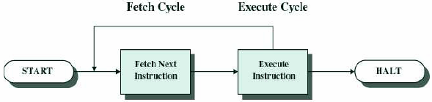
Computer System Operations
CPU fetches the instructions from memory and executes them. The basic cycle of CPU is to fetch the first instruction from memory, decodes it to determine its type and operands, execute it, and then fetch, decode, and execute subsequent instructions.
Program counter–contains the memory address of next instruction to be fetched.
Instruction register–holds the actual instruction.
The PSW (Program Status Word)-contains the condition code bits, which are set by comparison instruction, the CPU priority, the modes (user or kernel), and various other control bits.

Slide 28
Hardware Protection
Multiprogramming put several programs in memory at the same time. When one program contain erroneous data it might modify the program or data of another program.
OS must insure that an incorrect program can not cause other programs to execute incorrectly, and must terminate the such erroneous program.
Dual-Mode Operation
I/O Protection
Memory Protection
CPU Protection

Slide 29
Dual-Mode Operation
Provide hardware support to differentiate between at least two modes of operations.
1. User mode. execution done on behalf of a user.
User programs runs in user mode, which permits only the subset of instructions to be executed and subset of features to be accessed.
2. Kernel mode(or supervisor mode) . execution done on behalf of operating system.
OS runs in kernel mode, giving it access to the complete hardware.
Mode bit is added to the hardware of the computer to indicate the current mode: kernel(0) and user(1).

Slide 30
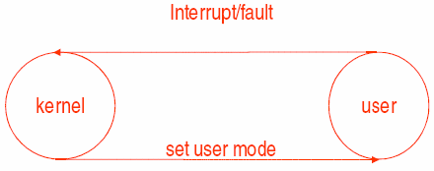
Dual-Mode Operation
When an trap or interrupt occurs hardware switches from user mode to the kernel mode. Thus, whenever the OS gains control of computer, it is in kernel mode. The system always switches to user mode before passing control to the user program.

Slide 31
I/O Protection
A user program may disrupt the normal operation of the system by issuing illegal I/O operation, by accessing memory locations within the OS itself.
All I/O instructions must be privileged instructions. Thus the user can not issue the I/O instruction directly.

Slide 32
Memory Protection
How to separate each program's memory space ?
How to handle relocation ?
In order to have memory protection, add two registers that determine the range of legal addresses a program may access:
Base register-holds the smallest legal physical memory address.
Limit register-contains the size of the range
Memory outside the defined range is protected.

Slide 33
CPU Protection
To prevent a user program from getting stuck in an infinite loop or not calling system services, and never returning control to the OS.
Timer-interrupts computer after specified period to ensure operating system maintains control.
Timer is decremented every clock tick.
When timer reaches the value 0, an interrupt occurs.
If the timer interrupts, control transfers automatically to the OS, which may treat the interrupt as a fatal error or may give the program more time.

Slide 34
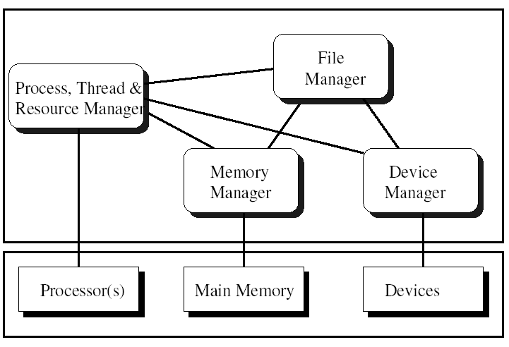
OS Organization or Components

Slide 35
Process Management
A process is a program in execution.
For example
A batch job is a process
A time-shared user program is a process
A system task (e.g. spooling output to printer) is a process.
Remember a program itself is not a process rather it is a passive entity.

Slide 36
Process Management
A process needs certain resources, including CPU time, memory, files, and I/O devices, to accomplish its task. These resources are either given to the process when it is created or when it is running.
When the process completes, the OS reclaims all the resources.
Process manager (OS) handle all these responsibility

Slide 37
Process Management
The operating system is responsible for the following activities in connection with process management.
Process creation and deletion.
Process suspension and resumption.
Provision of mechanisms for:
Process synchronization
Process communication

Slide 38
Memory Management
Memory is a large array of words or bytes, each with its own address.
It is a repository of quickly accessible data shared by the CPU and I/O devices.
Main memory is a volatile storage device. It loses its contents in the case of system failure.

Slide 39
Memory Management
The operating system is responsible for the following activities in connections with memory management:
Keep track of which parts of memory are currently being used and by whom.
Decide which processes to load when memory space becomes available.
Allocate and deallocate memory space as needed.

Slide 40
File Management
A file is a collection of related information defined by its creator. Commonly, files represent programs (both source and object forms) and data.
Most visible component of OS. Computers can store information on several different types of physical media (e.g. magnetic tap, magnetic disk, CD etc).
A file a logical storage unit, which abstract away the physical properties of its storage device.

Slide 41
File Management
The operating system is responsible for the following activities in connections with file management:
File creation and deletion.
Directory creation and deletion.
Support of primitives for manipulating files and directories.
Mapping files onto secondary storage.
File backup on stable (nonvolatile) storage media.

Slide 42
I/O Management
All computers have physical devices for acquiring input and producing output.
The I/O system consists of:
A memory management system for buffering and caching system
A general device-driver interface
Drivers for specific hardware devices
Disk management

Slide 43
Secondary Storage Management
The computer system must provide secondary storage to back up main memory since main memory is volatile.
Most modern computer systems use disks as the principle on-line storage medium, for both programs and data.

Slide 44
Secondary Storage Management
The operating system is responsible for the following activities in connection with disk management:
Free space management
Storage allocation
Disk scheduling

Slide 45
System calls
System calls provide the interface between a process and the operating system.
These calls are generally available as assembly language instructions.
Some systems also allow to make system calls from a high level language, such as C.
Example:
count = read(fd, buffer, nbytes)

Slide 46
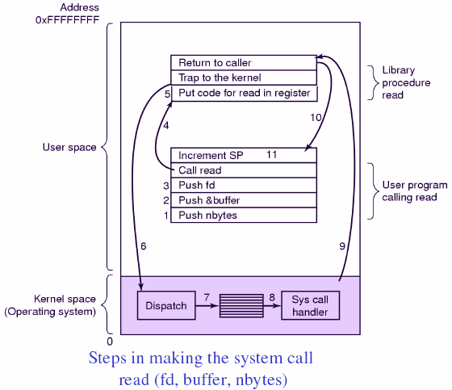
System Calls

Slide 47
Types of System Calls
Process control
load, execute, abort, end, create process, allocate and free memory, wait event etc.
Example
Pid=fork(), Creates a child process identical to parents.
exits(status), terminate the process execution and return the status.
Etc.

Slide 48
Types of System Calls
File management:
Create file, delete file, open, close, read, write, get file attribute etc.
Example
Read(fd, buffer, nbytes)
Write(fd, buffer, nbytes)
fd=open(file, how,….)
Close(fd)
etc.

Slide 49
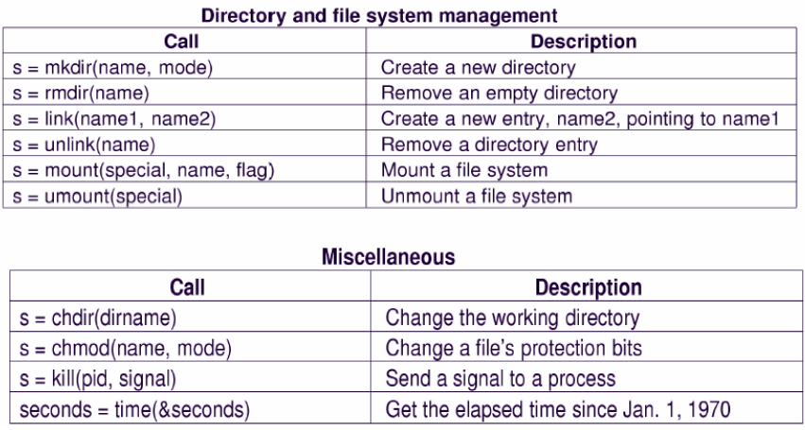

Slide 50
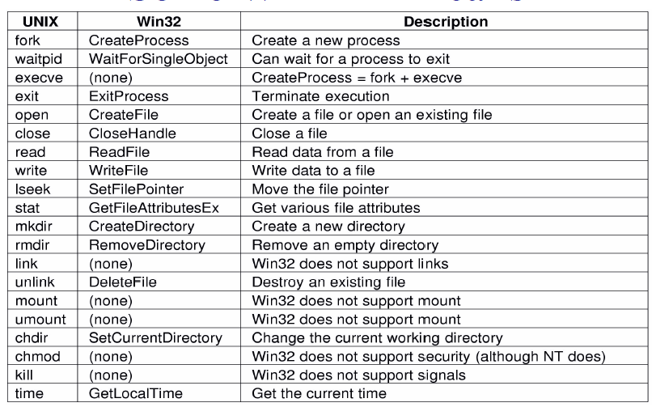

Slide 51
OS System Structure

Slide 52
Simple Structure
Many commercial systems do not have well-defined structures. Frequently, such operating systems started as small, simple, and limited systems and then grew beyond their original scope.
MS-DOS is an example of such a system. It was originally designed and implemented by a few people who had no idea that it would become so popular. It was written to provide the most functionality in the least space, so it was not divided into modules carefully.

Slide 53
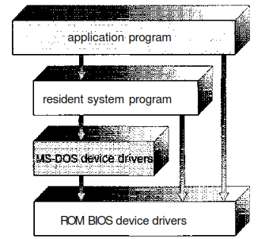
Simple Structure /Monolithic Structure
Figure: MS-DOS Structure

Slide 54
Simple Structure
In MS-DOS, the interfaces and levels of functionality are not well separated. For instance, application programs are able to access the basic I/O routines to write directly to the display and disk drives.
Such freedom leaves MS-DOS vulnerable to errant (or malicious) programs, causing entire system crashes
when user programs fail. Of course, MS-DOS was also limited by the hardware of its era. Because the Intel 8088 for which it was written provides no dual mode and no hardware protection

Slide 55
Layered approaches
Unix System is an example.
The UNIX OS consists of two separable parts.
Systems programs – use kernel supported system calls to provide useful functions such as compilation and file manipulation.
The kernel
Consists of everything below the system-call interface and above the physical hardware
Provides the file system, CPU scheduling, memory management, and other operating-system functions; a large number of functions for one level.

Slide 56
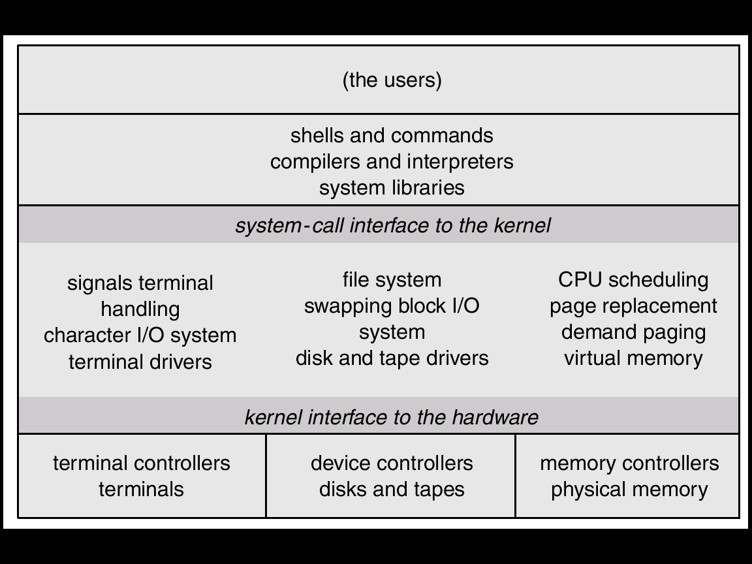
Unix System Structure

Slide 57
Layered approaches
The operating system is divided into a number of layers (levels), each built on top of lower layers. The bottom layer (layer 0), is the hardware; the highest (layer N) is the user interface.
Layered approach provides modularity. With modularity, layers are selected such that each layer uses functions (operations) and services of only lower-level layers.
Each layer is implemented by using only those operations that are provided lower level layers.
The major difficulty is appropriate definition of various layers.

Slide 58
Microkernel System Structure
Moves as much from the kernel into “user” space.
Communication takes place between user modules using message passing.
Benefits:
Easier to extend a microkernel
Easier to port the operating system to new architectures
More reliable (less code is running in kernel mode)
More secure

Slide 59
Microkernel
One benefit of the microkernel approach is ease of extending the operating system. All new services are added to user space and consequently do not require modification of the kernel.
When the kernel does have to be modified, the changes tend to be fewer, because the microkernel is a smaller kernel.
The resulting operating system is easier to port from one hardware design to another.

Slide 60
Virtual Machines
The fundamental idea behind a virtual machine is to abstract the hardware of a single computer (the CPU, memory, disk drives, network interface cards, and so forth) into several different execution environments, thereby creating the illusion that each separate execution environment is running its own private computer.

Slide 61
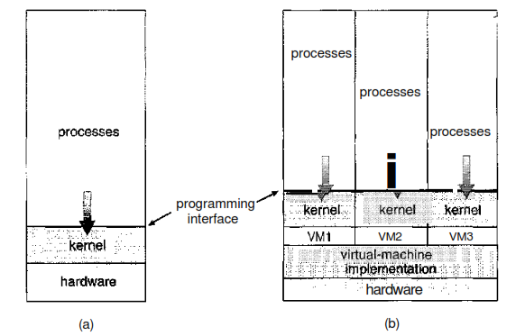
Virtual Machine
Figure: System models, (a) Nonvirtual machine, (b) Virtual machine

Slide 62
Virtual Machine
By using CPU scheduling and virtual-memory techniques, an operating system can create the illusion that a process has its own processor with its own (virtual) memory. Normally, a process has additional features, such as system calls and a file system, that are not provided by the bare hardware.
The virtual-machine approach does not provide any such additional functionality but rather provides an interface that is identical to the underlying bare hardware. Each process is provided with a (virtual) copy of the underlying computer

Slide 63
Shell
The shell is a command-line interface that allows the user to enter commands to interact with the operating system.
It acts as an intermediary between the user and the kernel, interpreting commands entered by the user and translating them into instructions that the kernel can execute.
The shell also provides various features like command history, tab completion, and scripting capabilities to make it easier for the user to work with the system.

Slide 64
Open Source OS

